Slide 1

Neighbor Overview
Apr 15, 2019

Slide 2





Improve Engagement
Drive Growth
Multi-Service Billing
Simplify Operations
Consumer-First Billing

Slide 3


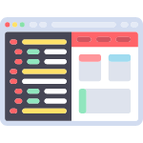
What We’re Building
Neighbor Hub
(Admin Portal)
Neighbor Home
(User Portal)
Neighbor API Platform
Core Billing & Invoicing
Accounting and Reporting
Accounting Systems
Products Catalog, Promotions & Pricing
Taxation
CRM/CPQ
Customer Management
Ratings Engine
Payment Gateways
Analytics Engine
Revenue Retention
Support Systems
Provisioning Systems
Payment Gateway Integrations
Ticketing

Slide 4
Current Features

Slide 5



Core Billing and Invoicing
Charge Models
Billing Features
Invoicing
Supports charge models for one-time, fixed recurring, hybrid and usage based billing
Send automated invoices monthly, semi-annually and annually
Configure multiple invoice cycles for different billing groups
Automatic proration
Transaction level view for all customers and purchase
Ratings engine for real-time usage rating
General Ledger codes
Accounting extracts
Import payment data
Custom branded invoices, streamlined and designed for simplicity
Ability to show multiple products and services on one invoice

Slide 6



Customer and Product Catalog Management
Customer Management
Product Catalog
Taxation
Manage customer accounts, purchases, payments and invoices
Track customer history and record notes
Multi tenant vendor support
Streamlined user experience, minimizing unnecessary screens and clicks
Automatic branded emails for new accounts, purchases or invoices
Creation of customized products for any type of service
Customized pricing models and features
Billing in advance and billing in arrears
Ability to create custom fields for products and features
Canadian wide taxation rules built in
Ability to specify taxes at a feature and account level
Support for tax exemptions

Slide 7

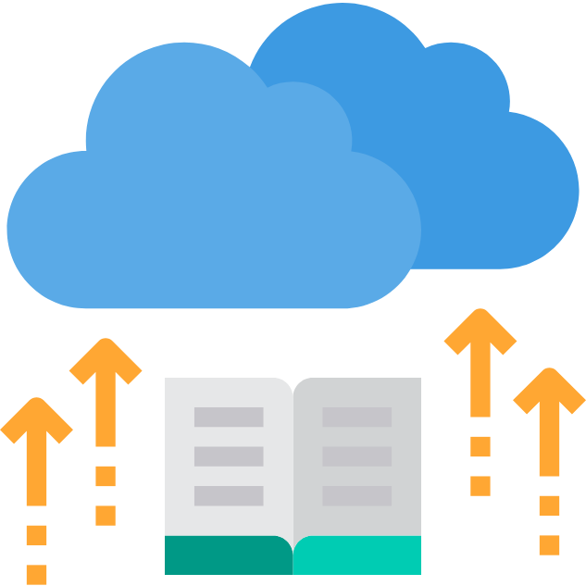

APIs, Infrastructure and Security
REST APIs
Infrastructure
Security
Developer first API platform, allowing for easy expandability and integration with existing best-in-class third-party systems
Seamless integration with CIS/CRM, Accounting, ERP, and ticketing platforms
Cloud-first architecture allowing easy scalability, high availability, redundancy and resilience.
User roles and permissions
Audit logs for traceability
Streamlined and secure login experience using single sign-on

Slide 8
Roadmap

Slide 9
R0.1
R0.2
R0.3
R0.4
R0.5
R0.6
R0.7
R0.8
R0.9
R1.0
Sponsor Telecom Billing
Enhancements & Automated Testing
Product Catalog Mgmt
Payment Integration
Billing Improvements
Roles and Permissions
Vendor Management
Global Search
Ticketing
End Customer Portal
System Architecture
Customer Management Enhancements
Create Products and Features
Payment Gateway Support
Billing Frequencies
System Users
Vendor Configuration
Neighbor Hub Search
Neighbor Ticketing Module
Neighbor Home
Environment and CICD
Automated Testing Framework
Usage Based Billing
Stripe Integration
Multiple Invoice Cycles
Roles Management
Vendor Setup Wizard
Backend Pagination
Data Imports
API Platform (Public)
Transaction and Invoice
Generation
Basic Accounting Extracts
Canada Tax Support
Bambora Integration
Overage
Auth0
Hub Redesigns
Reporting
Audit Logs
Security and Reliability
Customer Management
Multi-Vendor Support
Backbilling
Rules Engine
Revenue Retention
Unified Bill Design
UI/UX Enhancements
Partner Invoice Branding
Neighbor Hub
API Platform (Private)
Utilities, Telecom and monthly recurring billing customers
Full fledged API platform
Neighbor Ticketing Integrated with Hub. Start selling ticketing
Customer Onboarding
All Sponsor Telecom Customers for billing
Sponsor Partners and Get Energy for Telecom billing
New customers with flat fee, monthly recurring billing
Notes:
Future: Telecom ratings engine, Sales force integration, zendesk integration, customer self-serve, analytics and insights, promotion/offer management

Slide 10
Screenshots

Slide 11
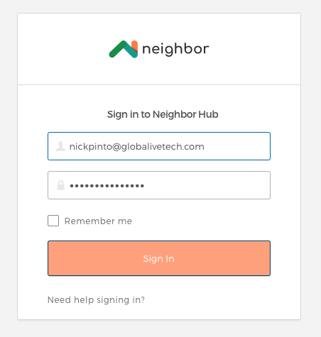
Sign In

Slide 12
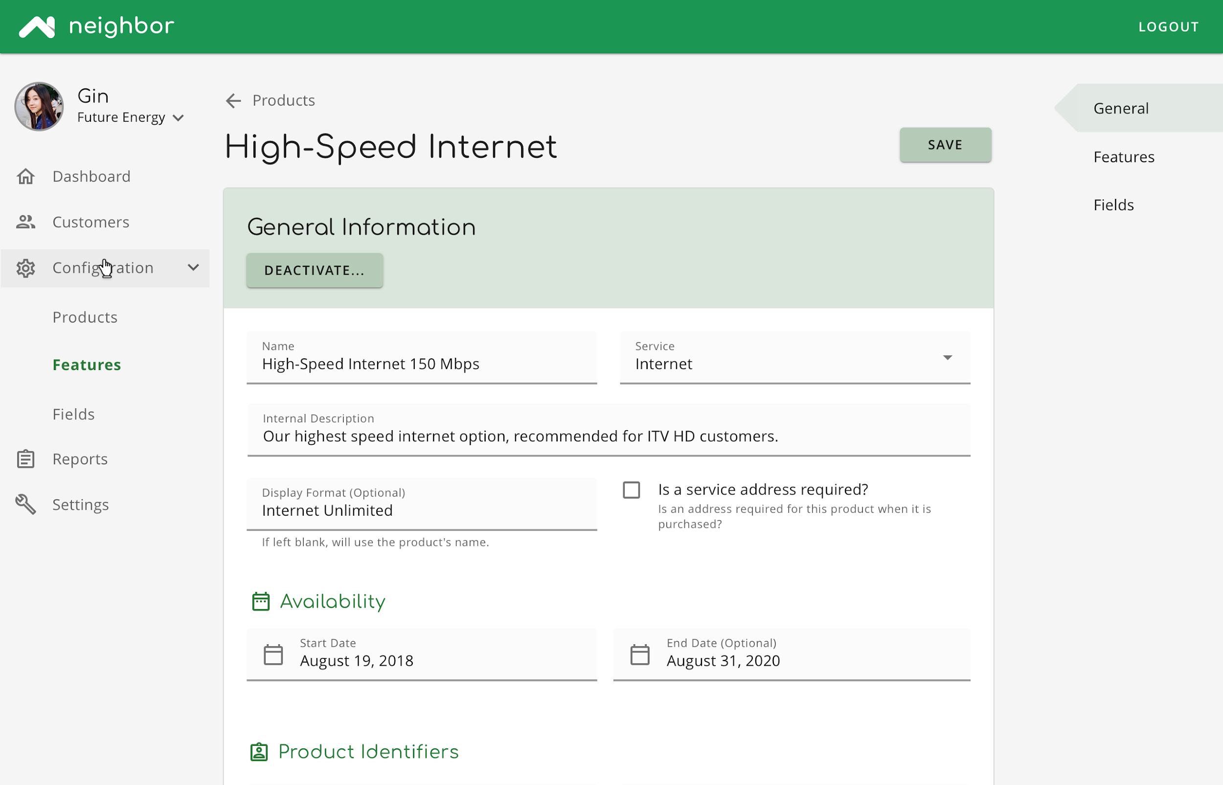
Admin Portal

